Slide 1

A Lightweight Benchmark
Logging Farm
Zekun Song

Slide 2
Content
01
03
02
04
Background of Benchmark
Results Demonstration
Pipeline of Implementation
Summary

Slide 3
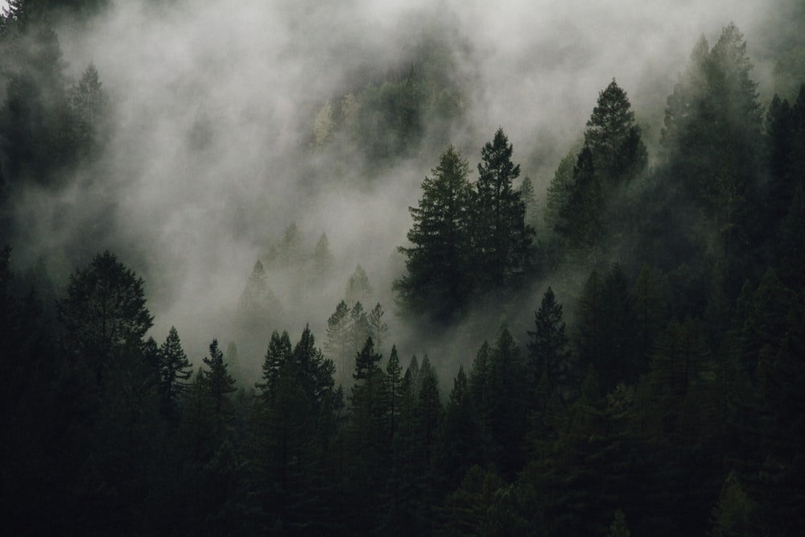
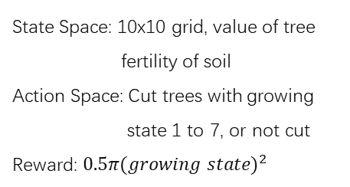
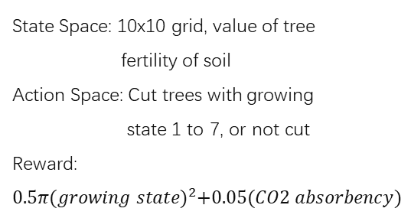
Implementation
Version 1
State Space: 10x10 grid, value of tree
Action Space: Cut trees with growing state 1 to 7, or not cut
Reward: [0, 1, 4, 9, 16, 25, 36, 49]
Version 4
Version 2
State Space: 10x10 grid, value of tree
fertility of soil
Action Space: Cut trees with growing state 1 to 7, or not cut
Reward: $0.5π{(growing state)}^{2}$
State Space: 10x10 grid, value of tree
Action Space: Cut trees with growing state 1 to 7, or not cut
Reward: [0, 1, 4, 9, 16, 25, 36, 49],
0 if not surpass threshold
Version 3
Version 5
State Space: 10x10 grid, value of tree
Action Space: Cut trees with growing state 1 to 7, or not cut
Reward: [0, 1, 4, 9, 16, 25, 36, 49] +
[0, 5, 10, 15, 20, 25, 30]
State Space: 10x10 grid, value of tree
fertility of soil
Action Space: Cut trees with growing state 1 to 7, or not cut
Reward:$0.5π{(growing state)}^{2}+0.05(CO2 absorbency)$

Slide 4
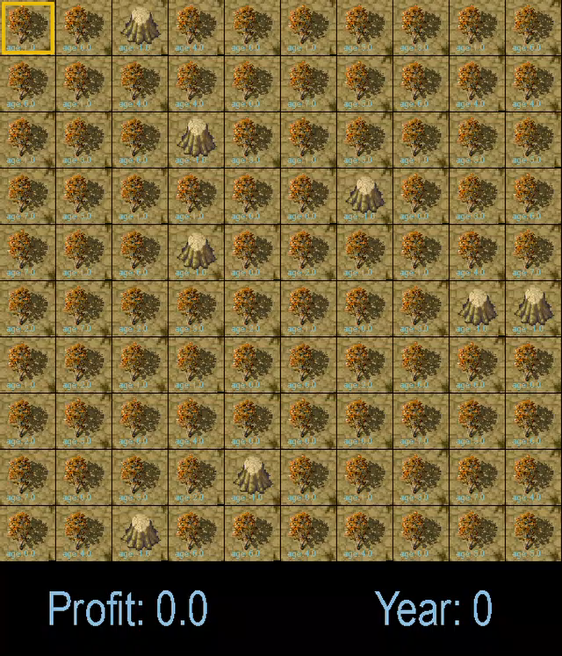
Graphic and Interaction of Environment
Basic Control of Game
Arrow keys control the movement of yellow frame.
Key “n” to move to next year.
Key “0” to “7” cut trees with corresponding growing state.

Slide 5

Impact of Seeds on Training

Slide 6
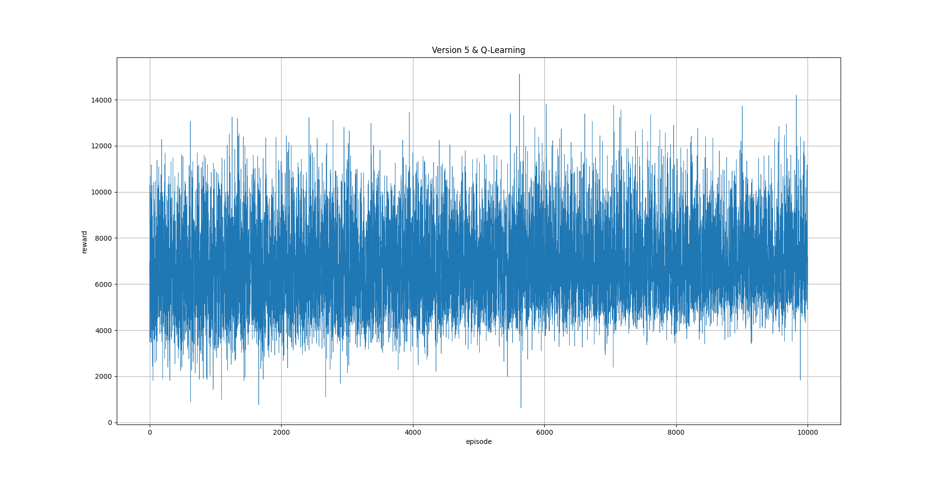
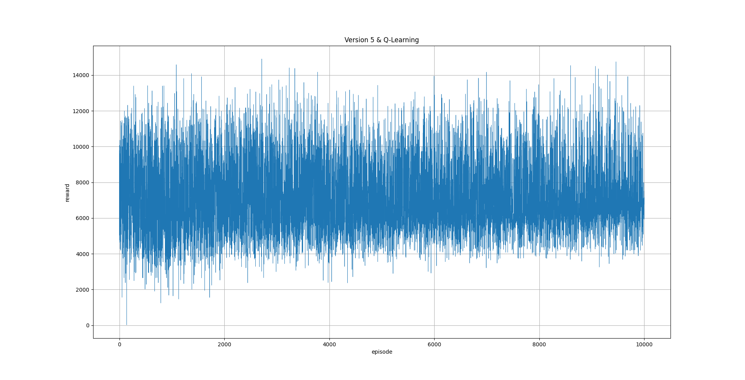
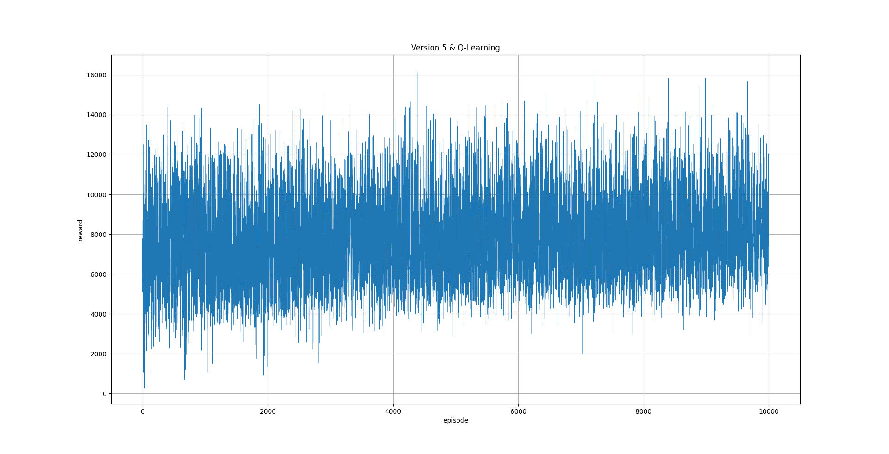
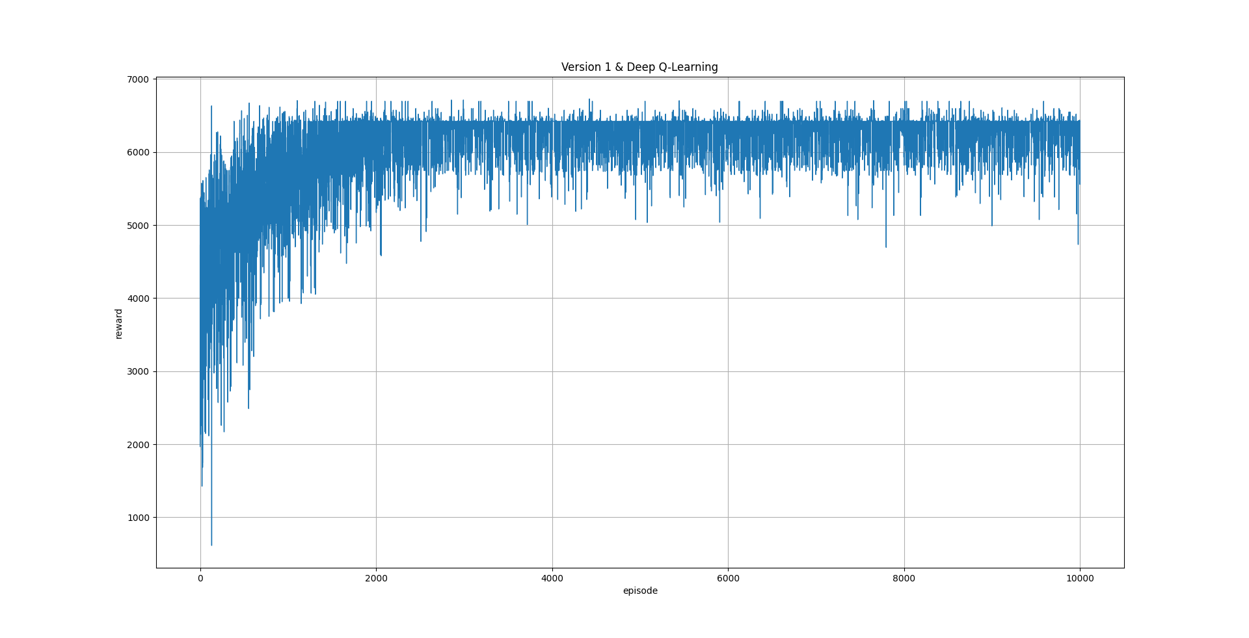
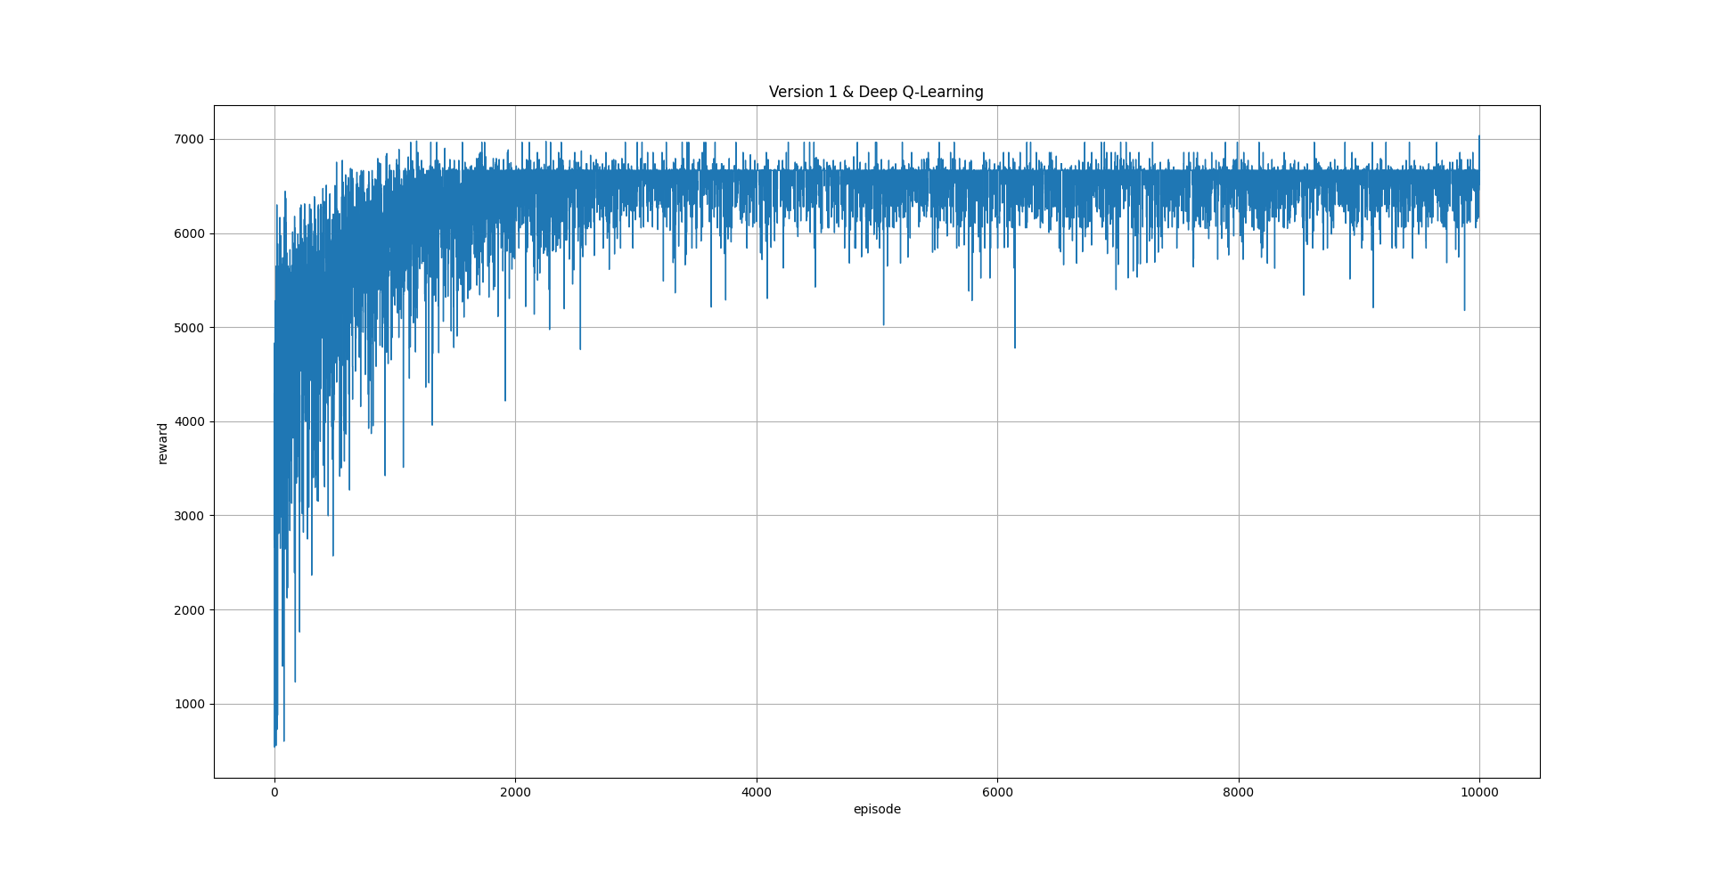
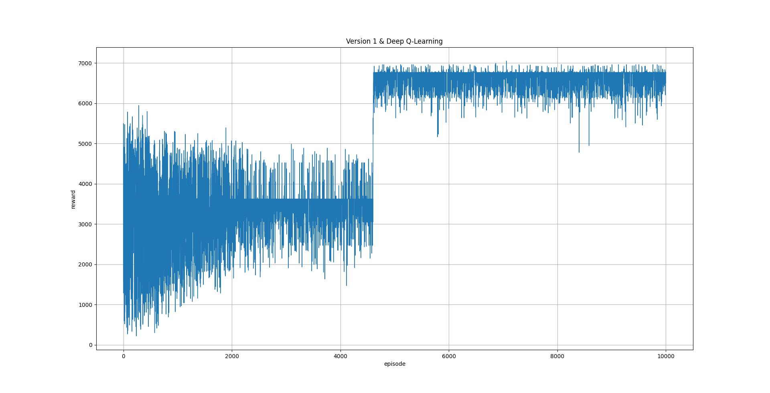
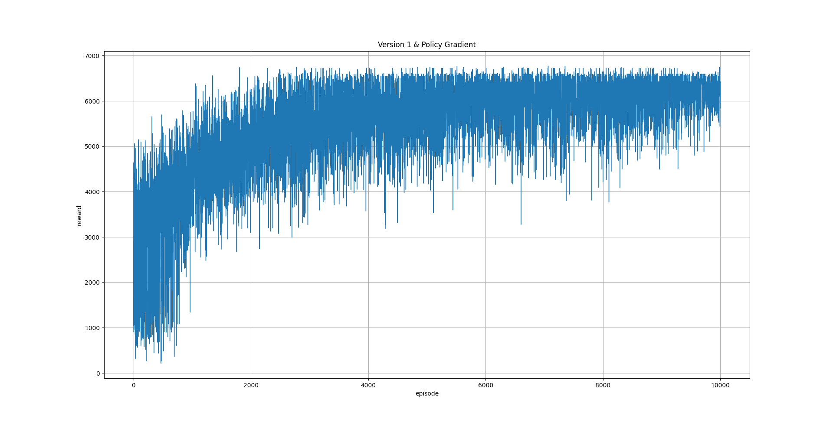
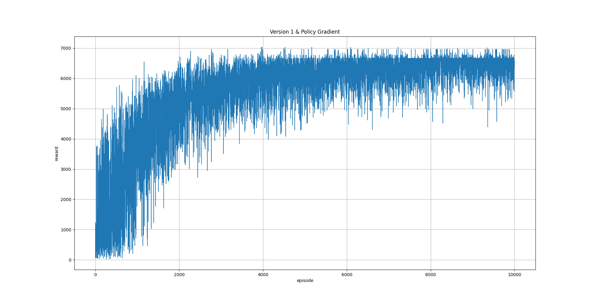
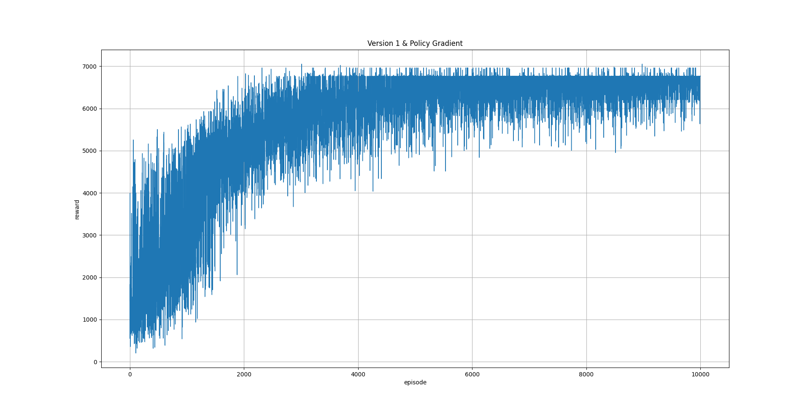
Version 1
Seed 0
Seed 1
Seed 2
Q-Learning
Deep Q-Learning
Policy Gradient

Slide 7
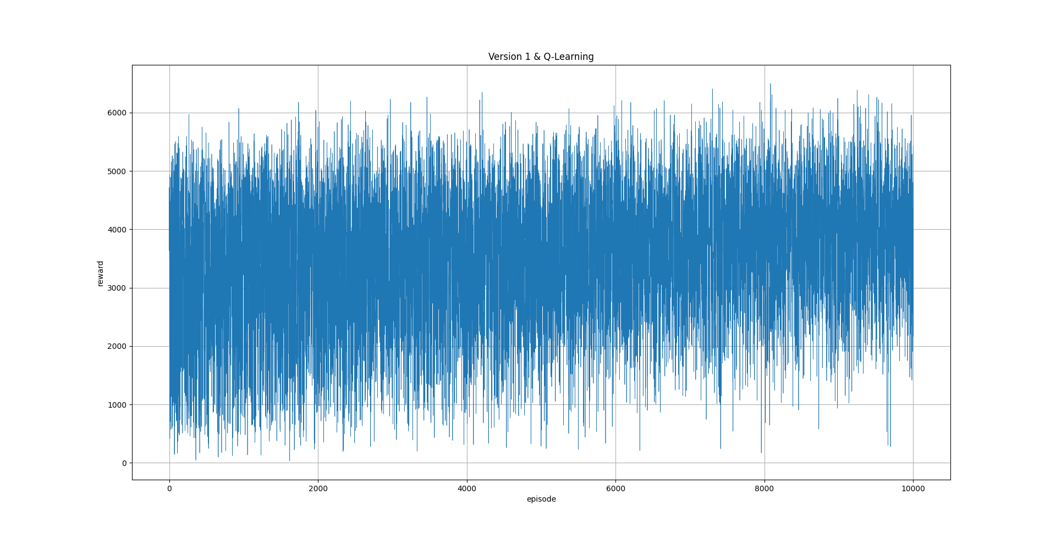
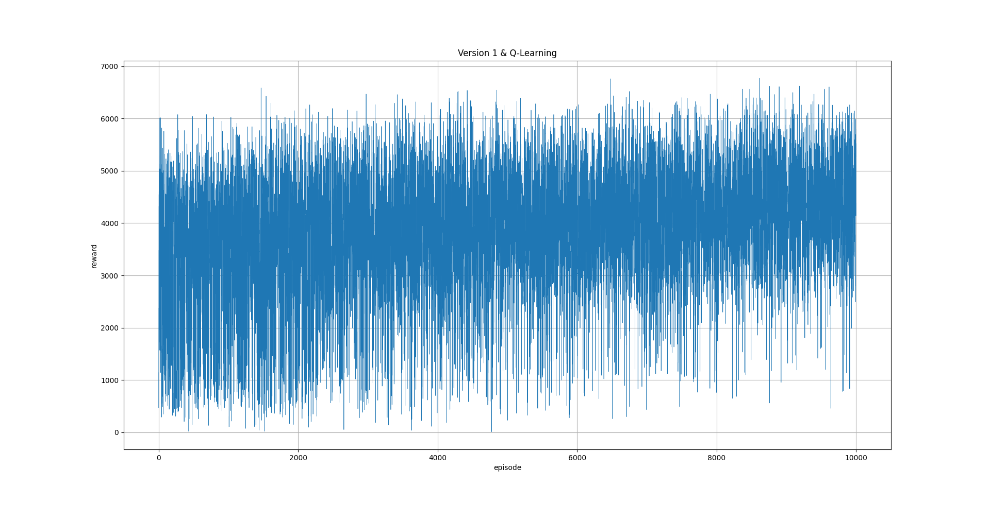
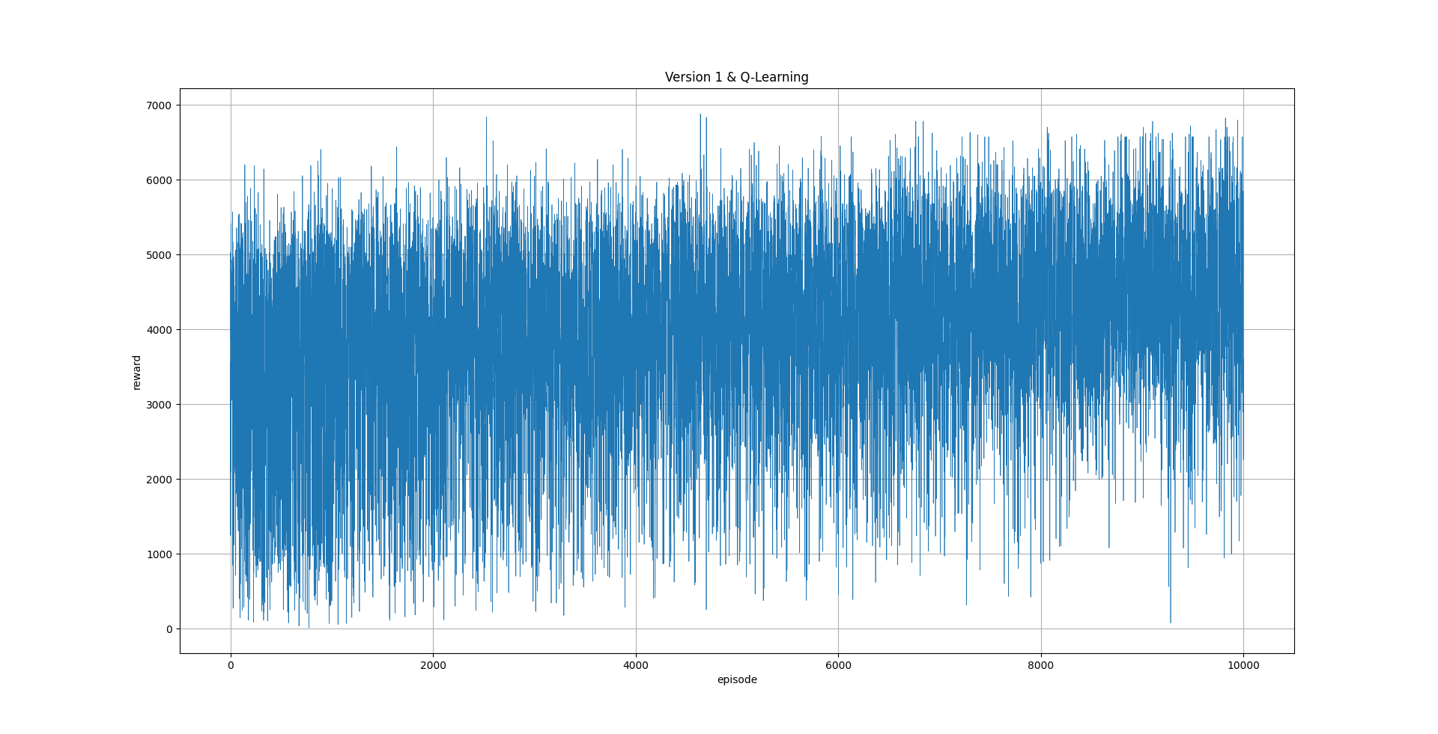
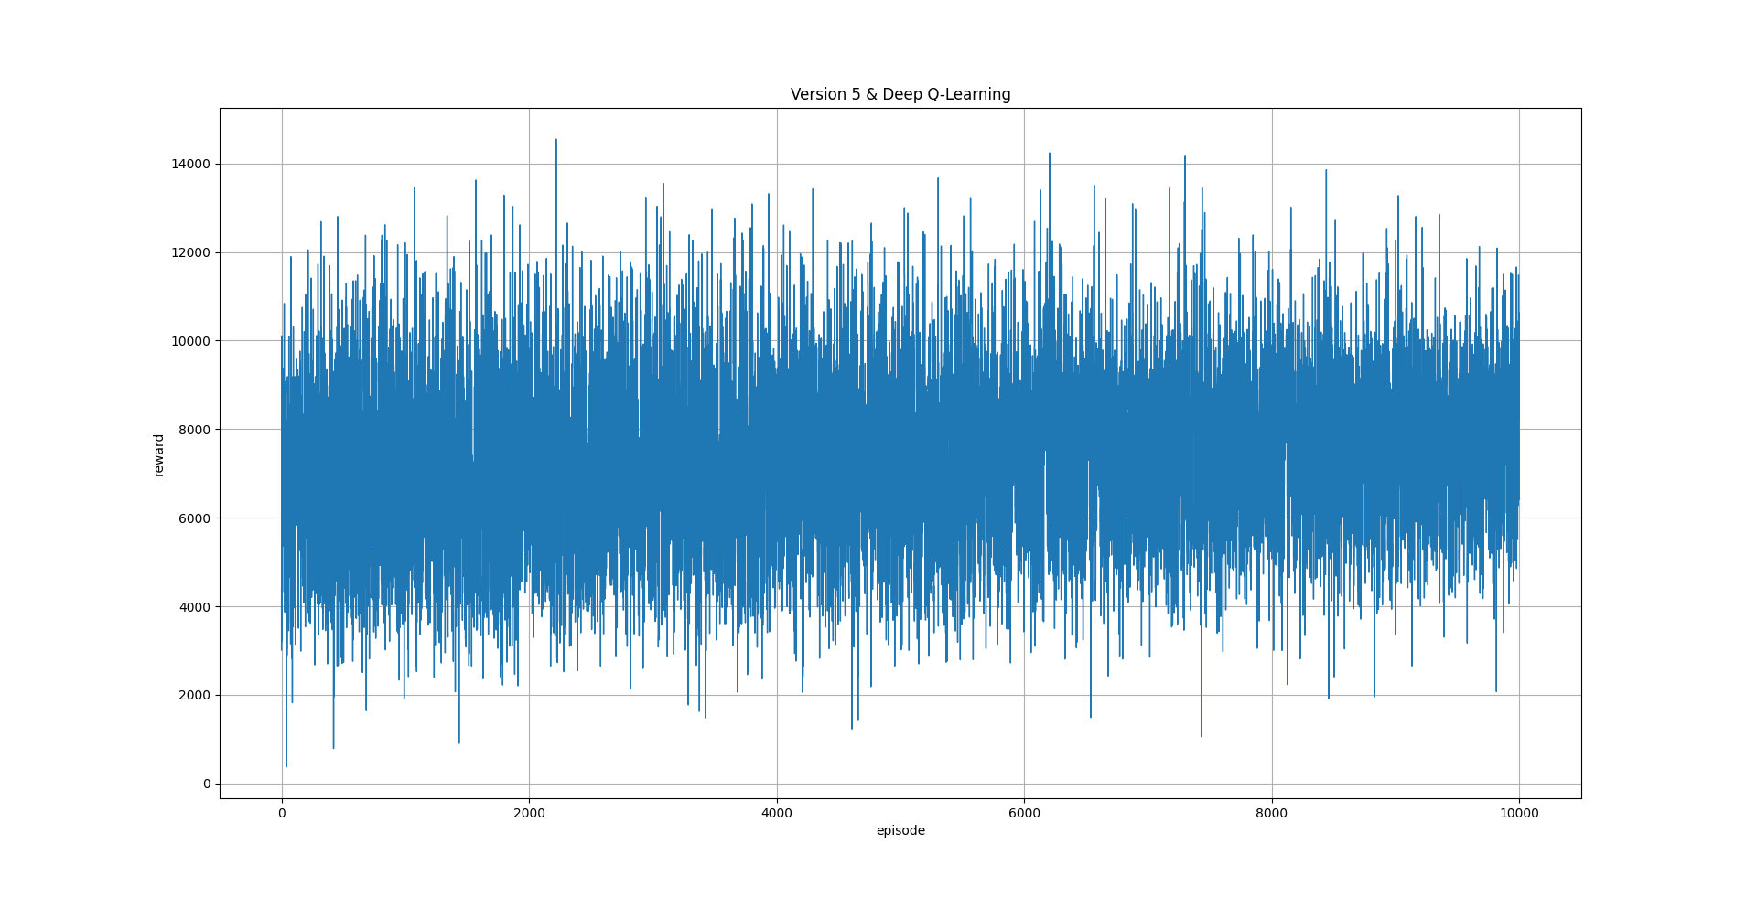
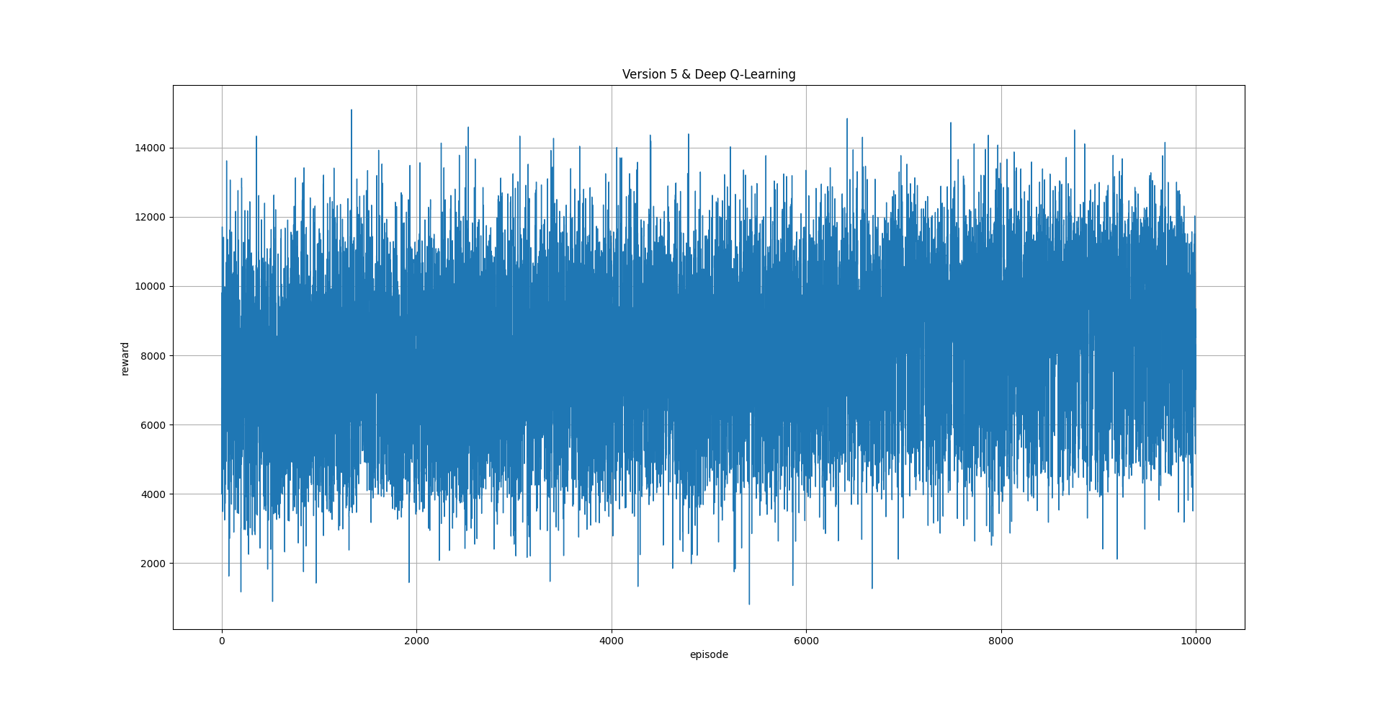
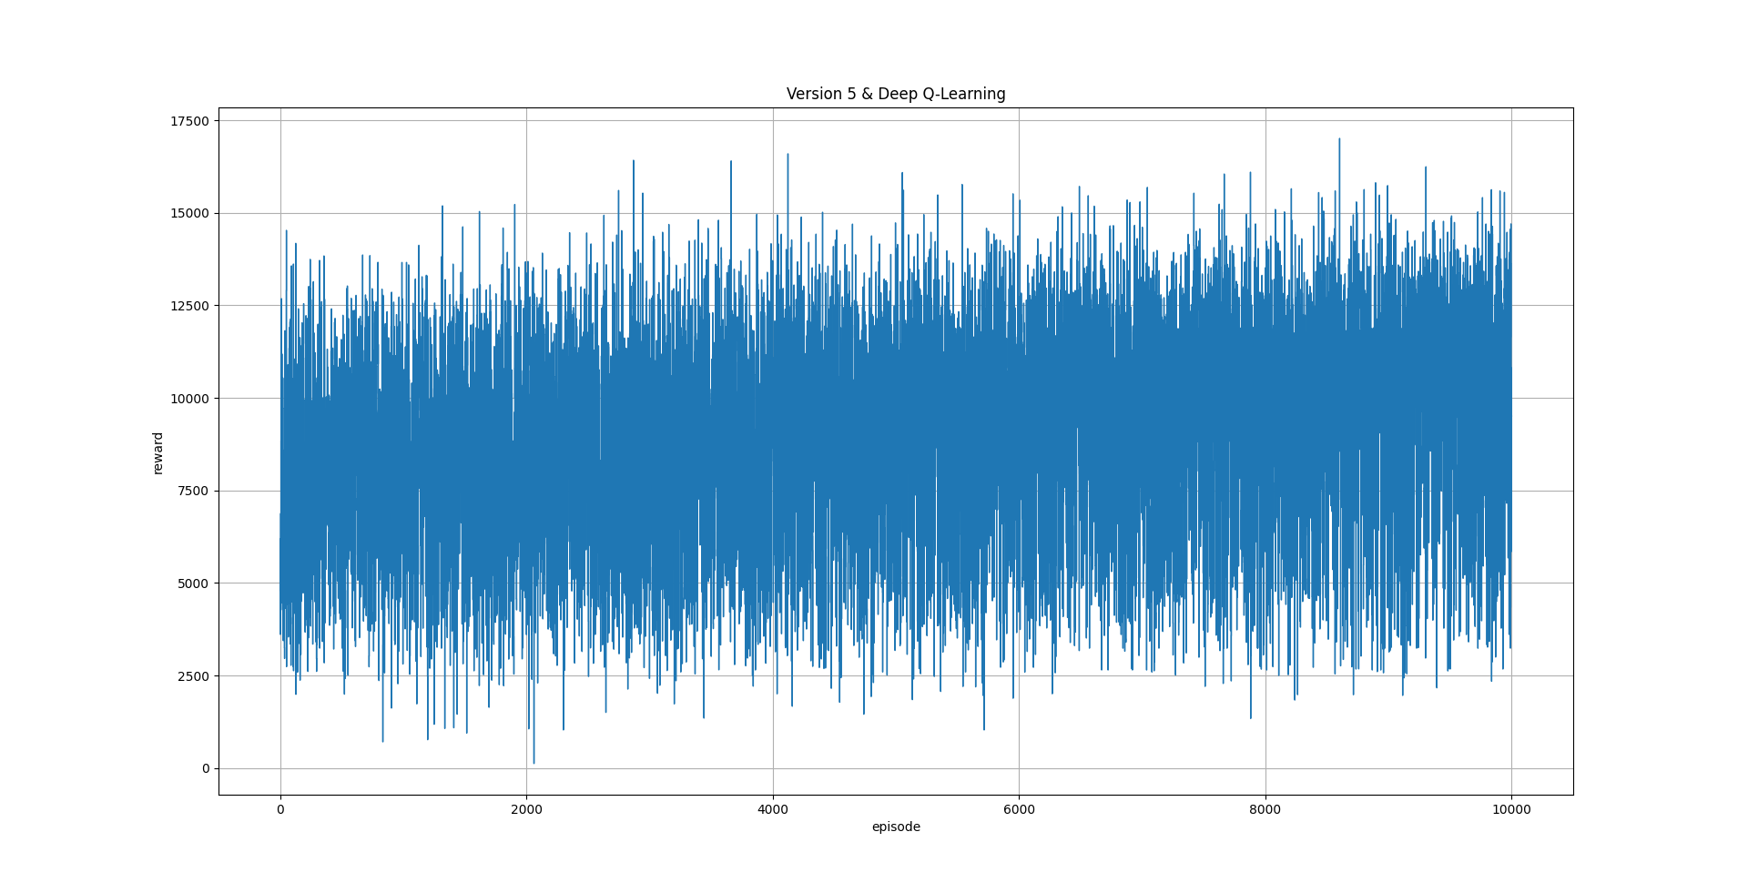
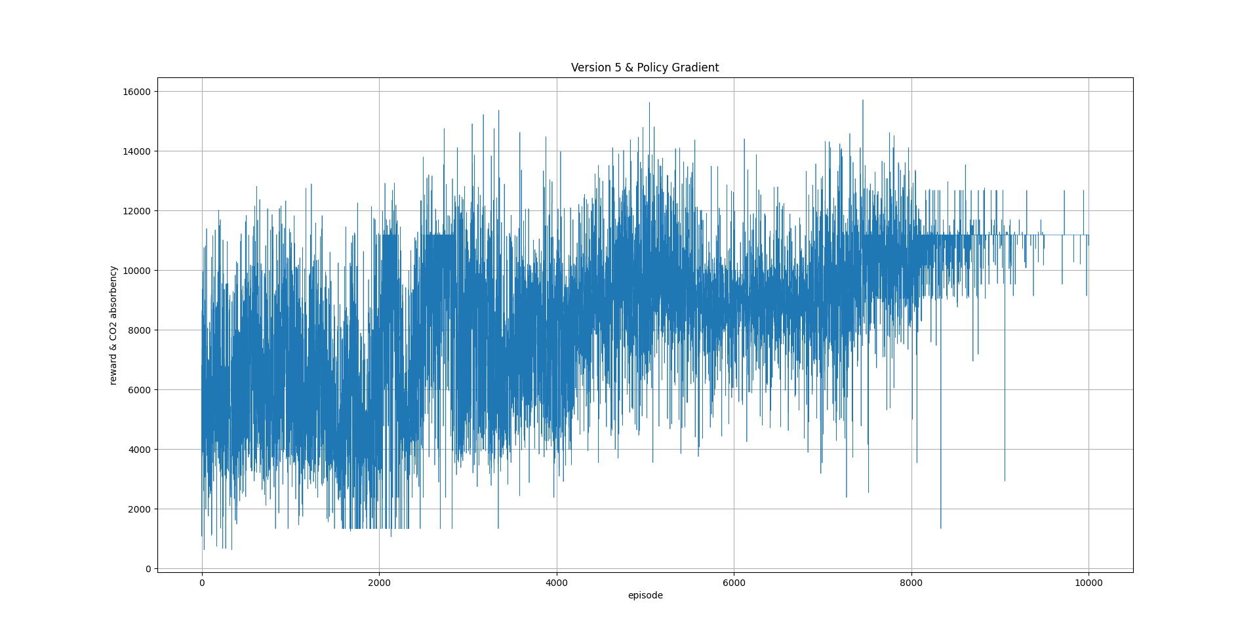
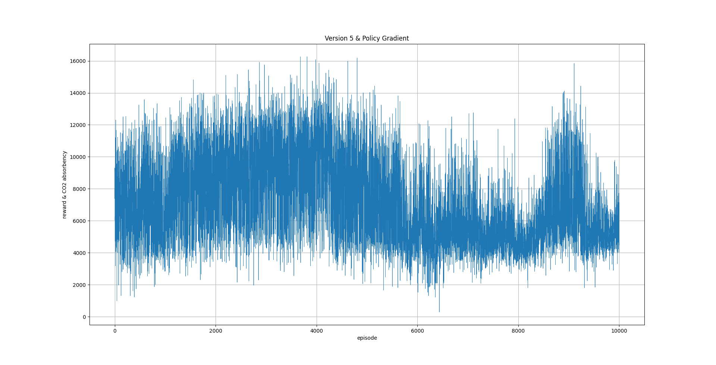
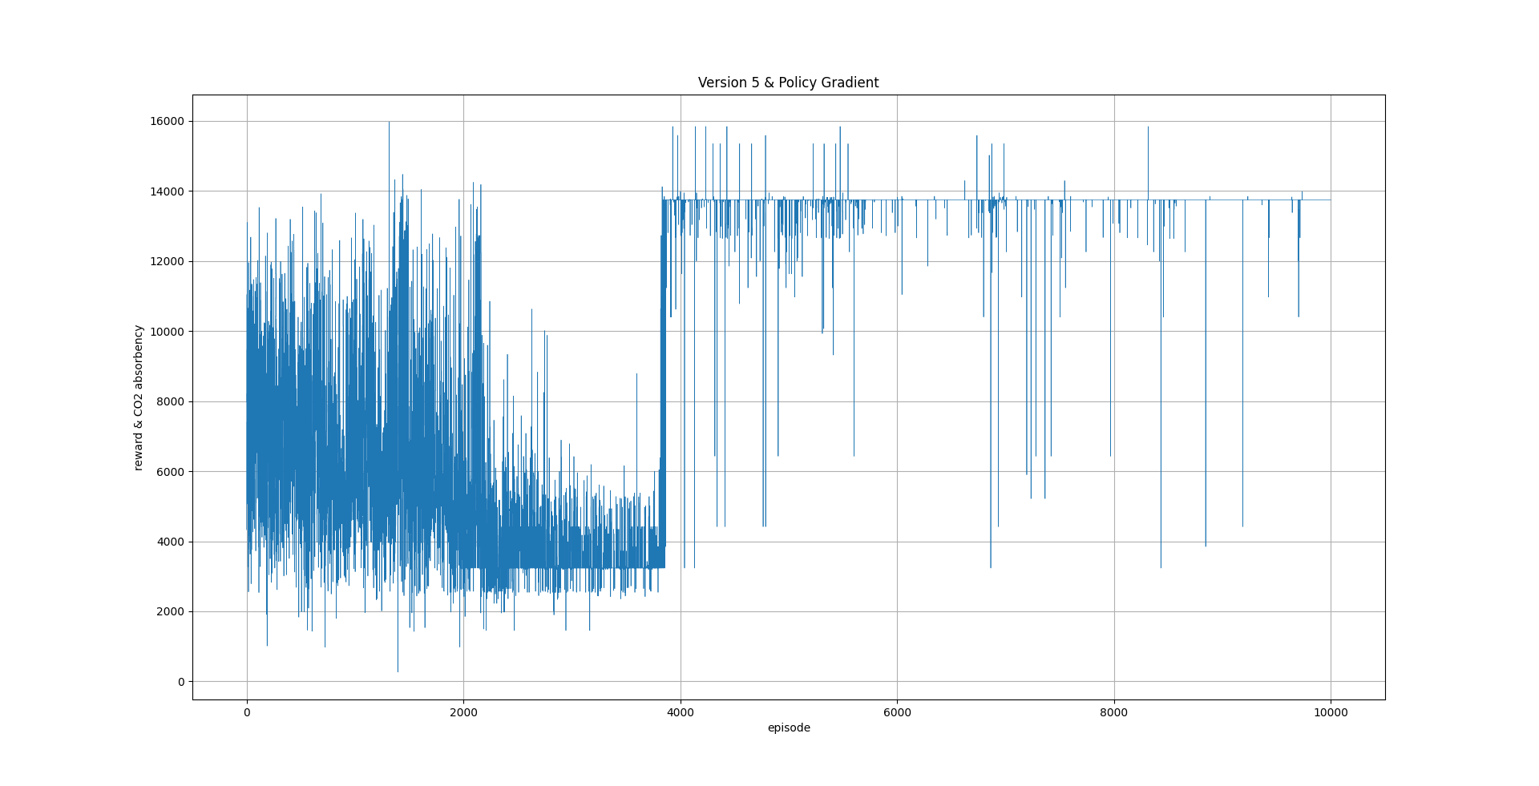
Version 5
Seed 0
Seed 1
Seed 2
Q-Learning
Deep Q-Learning
Policy Gradient

Slide 8
Evaluation Results

Slide 9
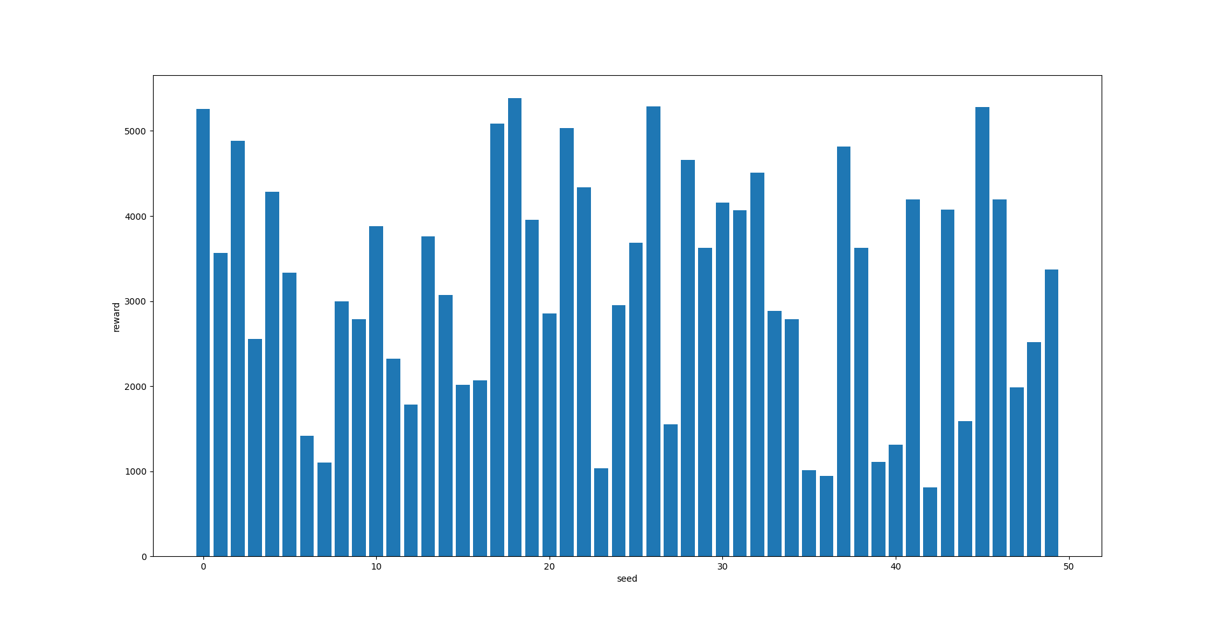
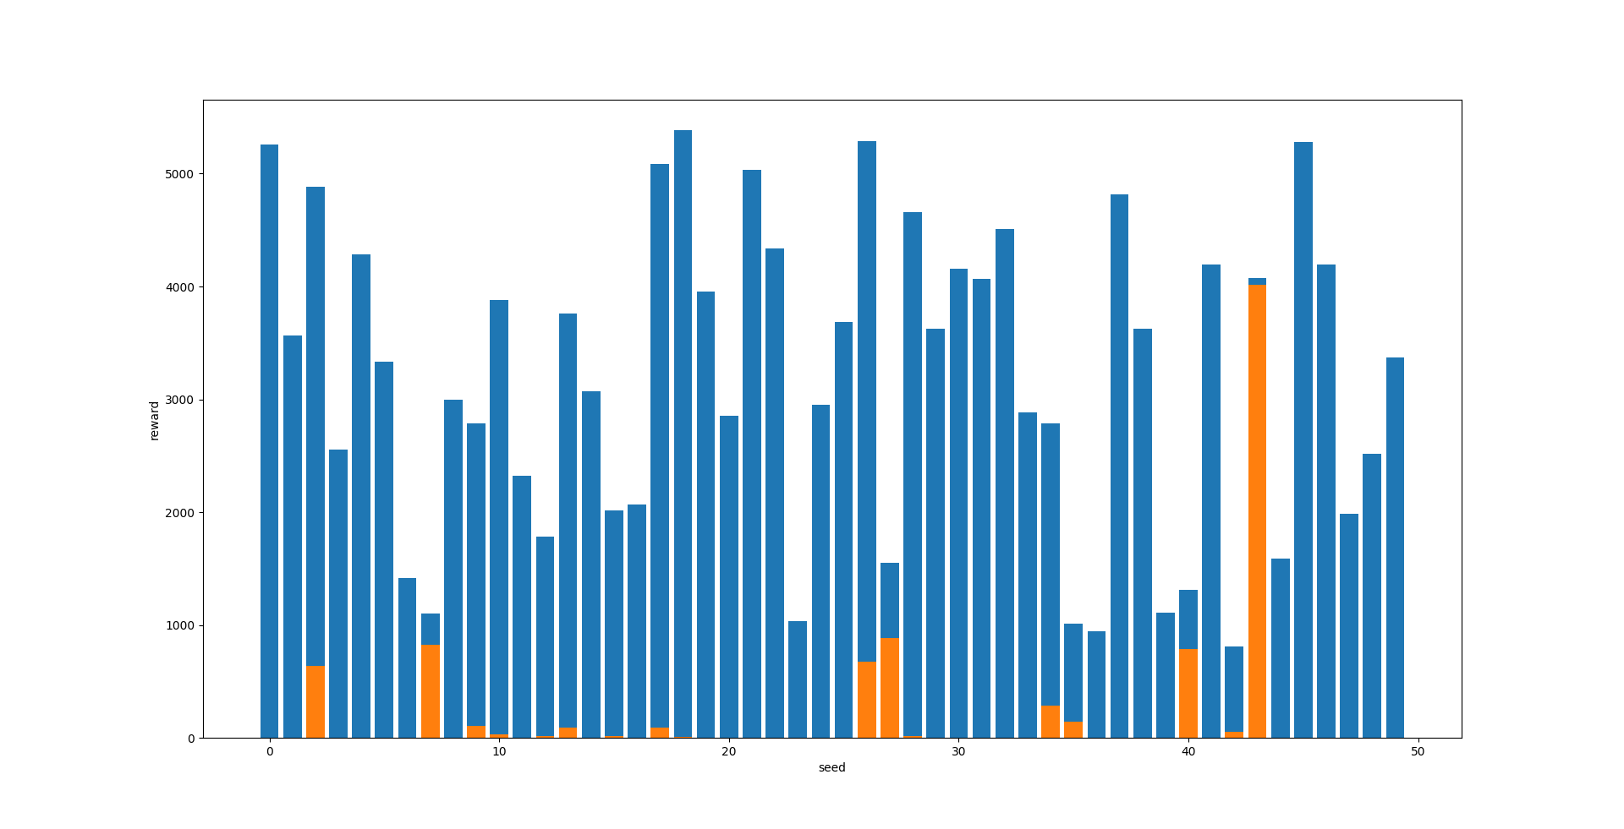
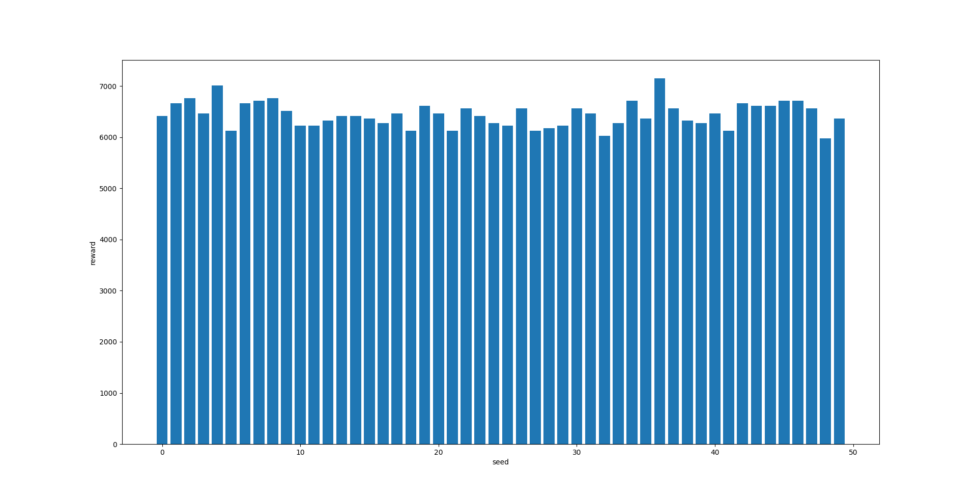
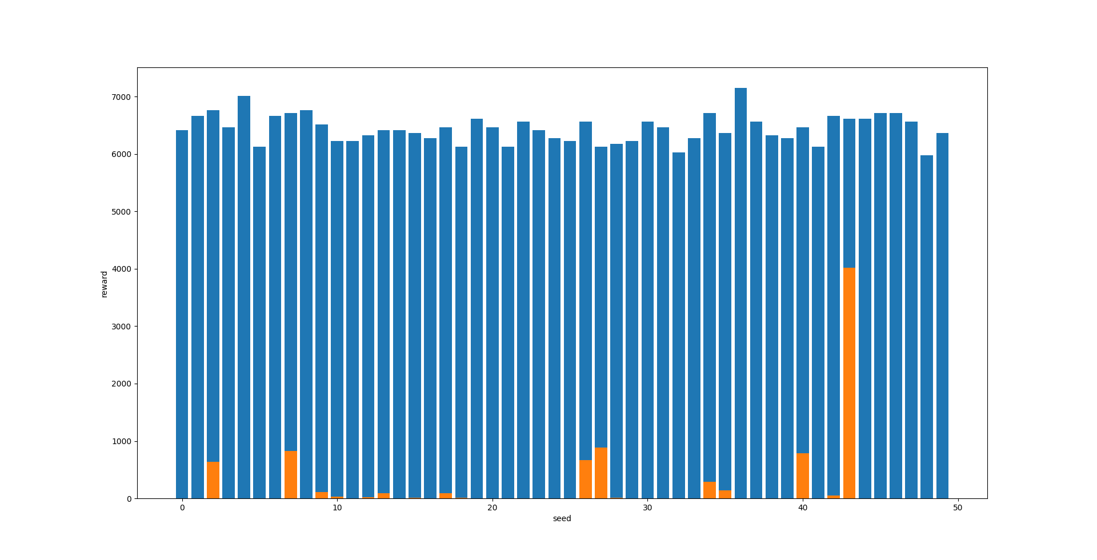
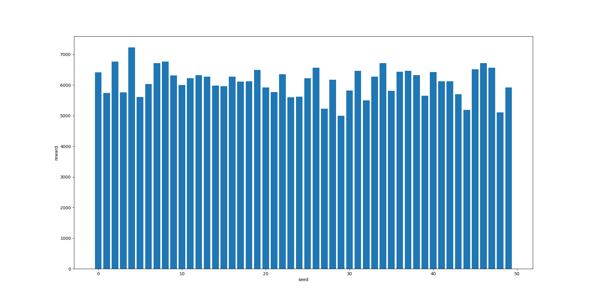
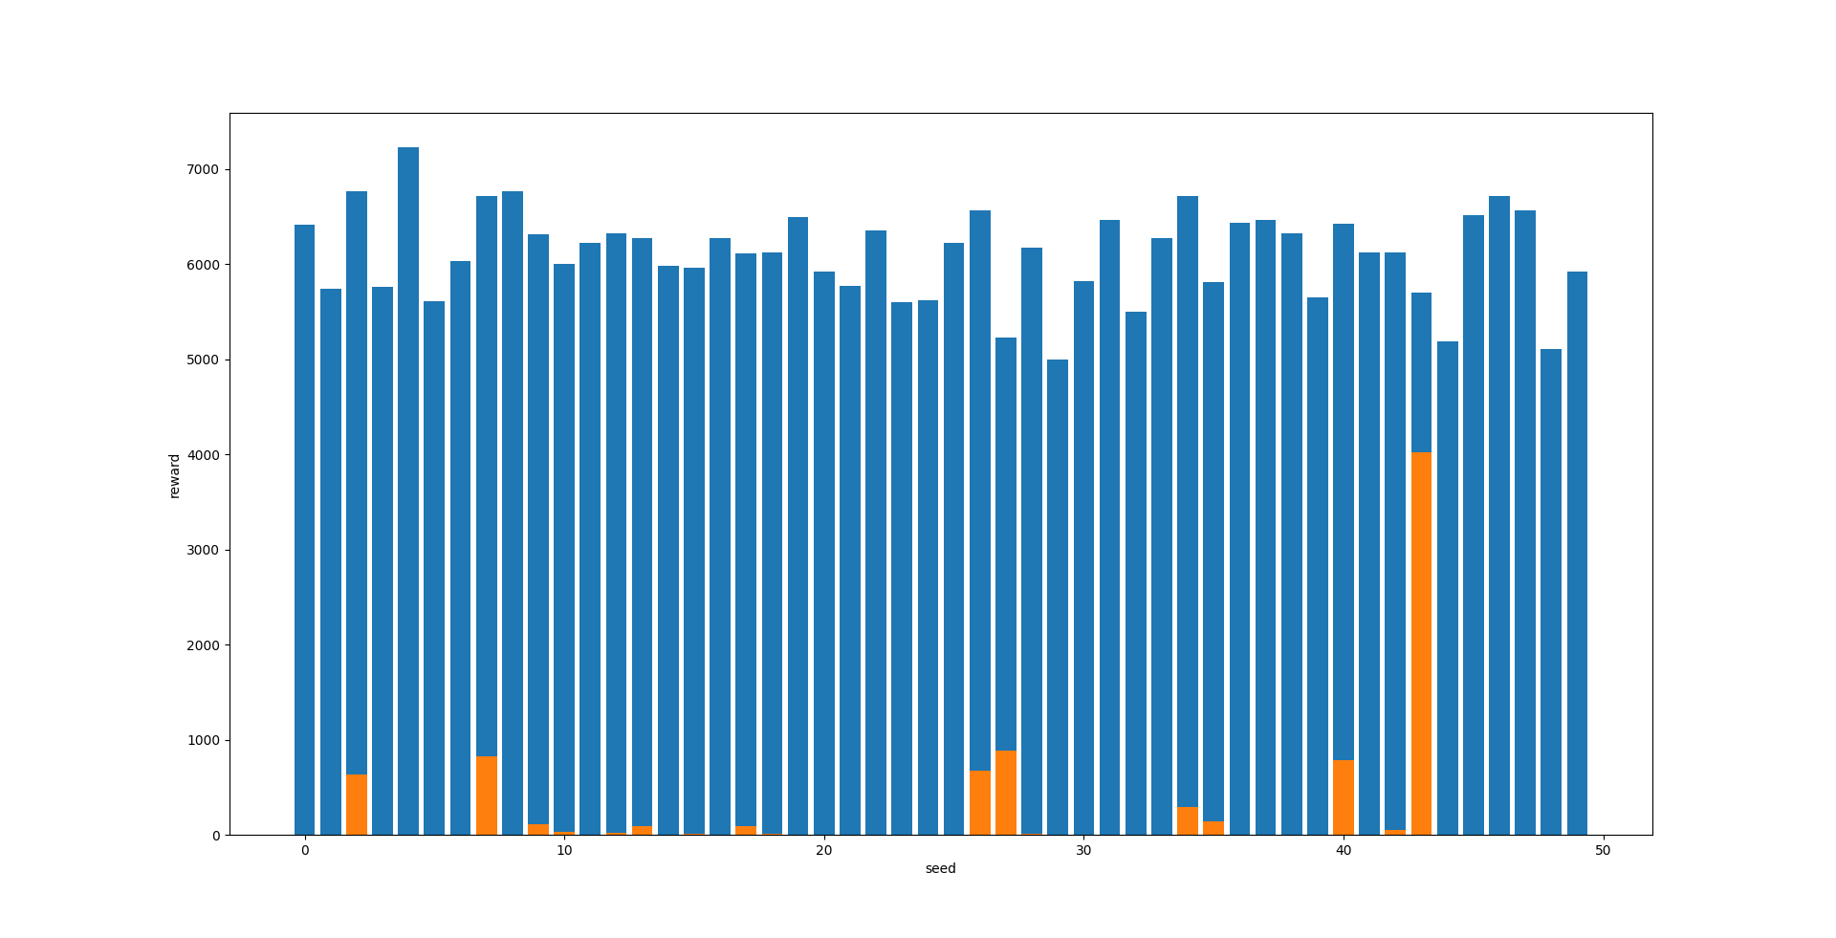
Version 1
Q-Learning
Deep Q-Learning
Policy Gradient

Slide 10
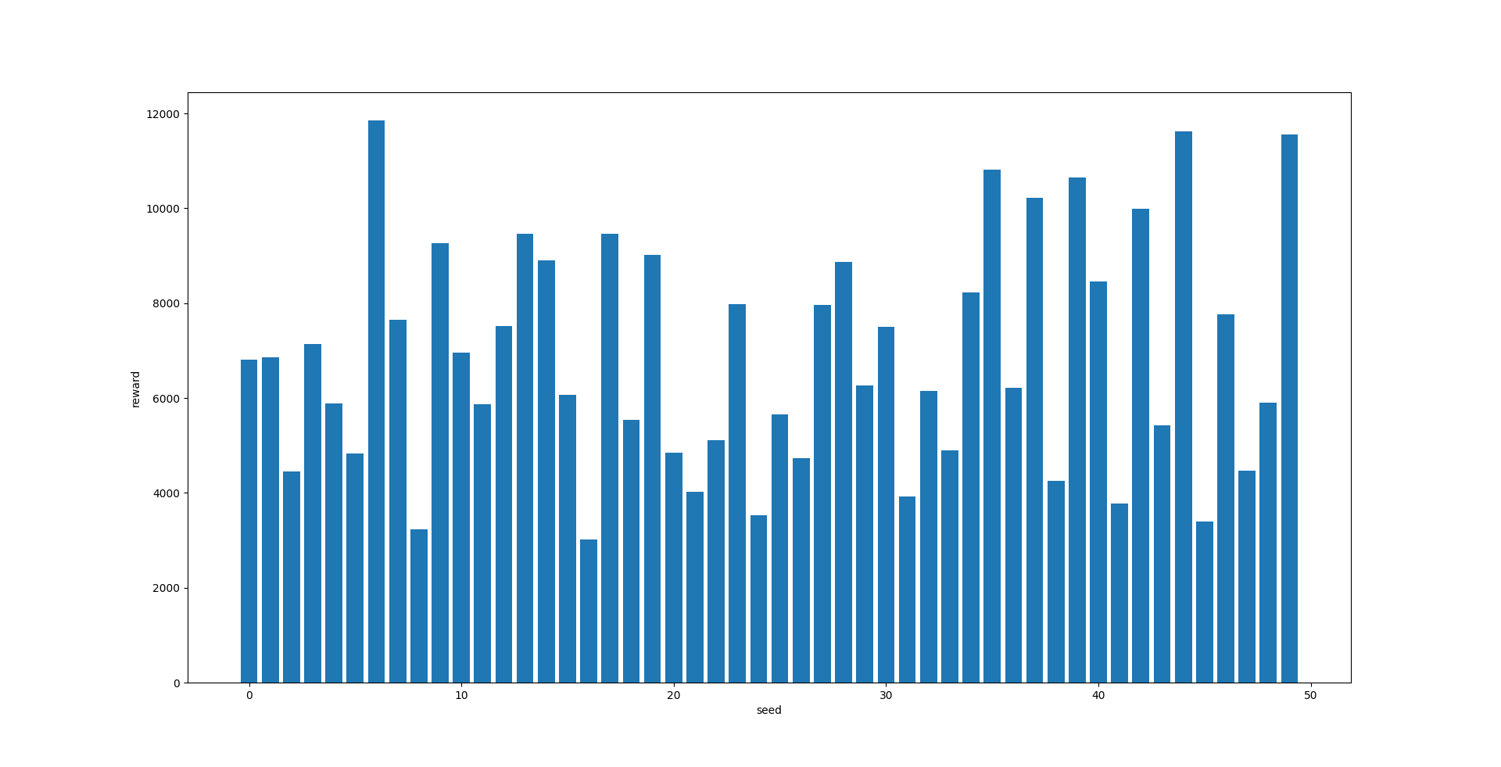
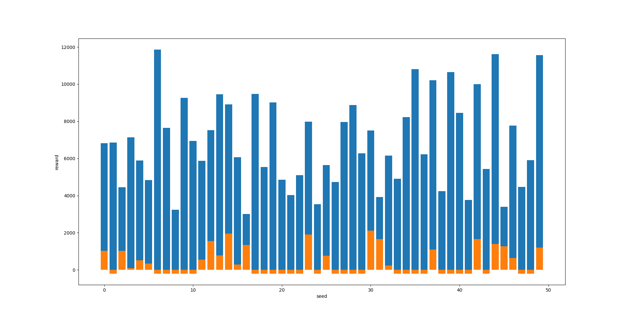
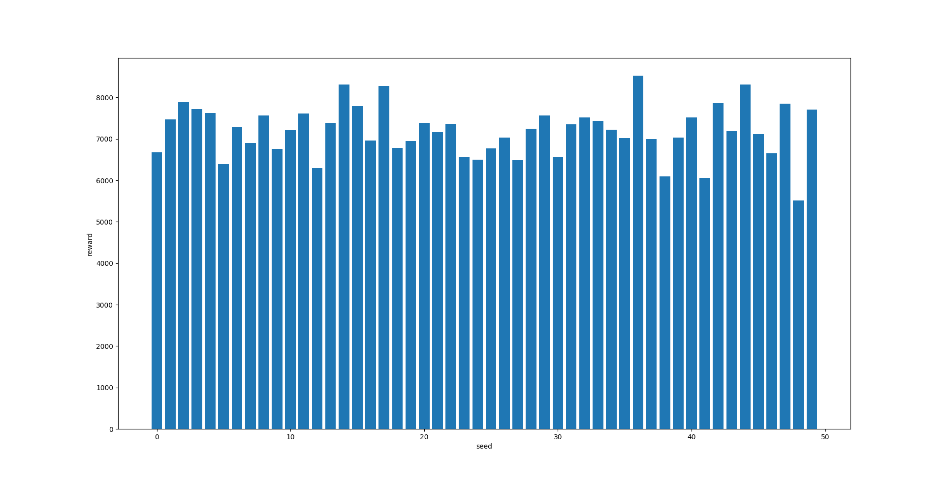
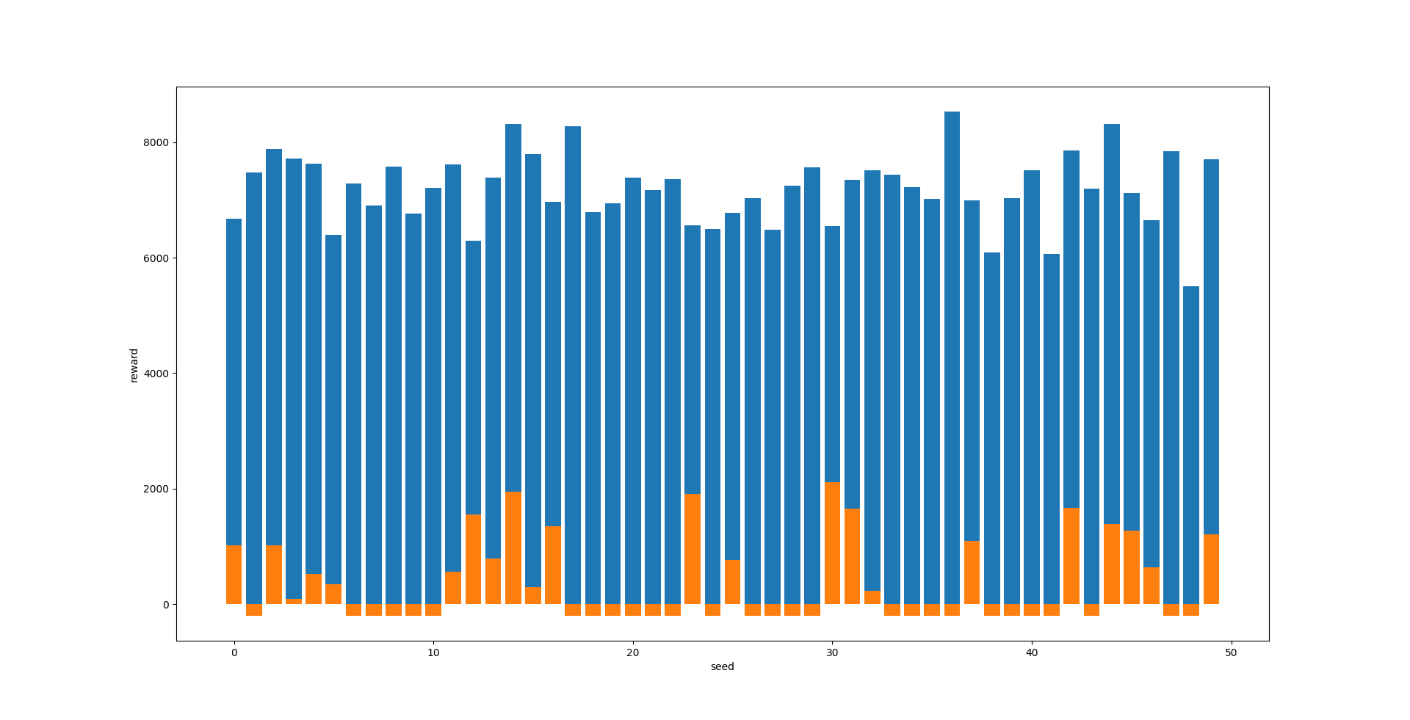
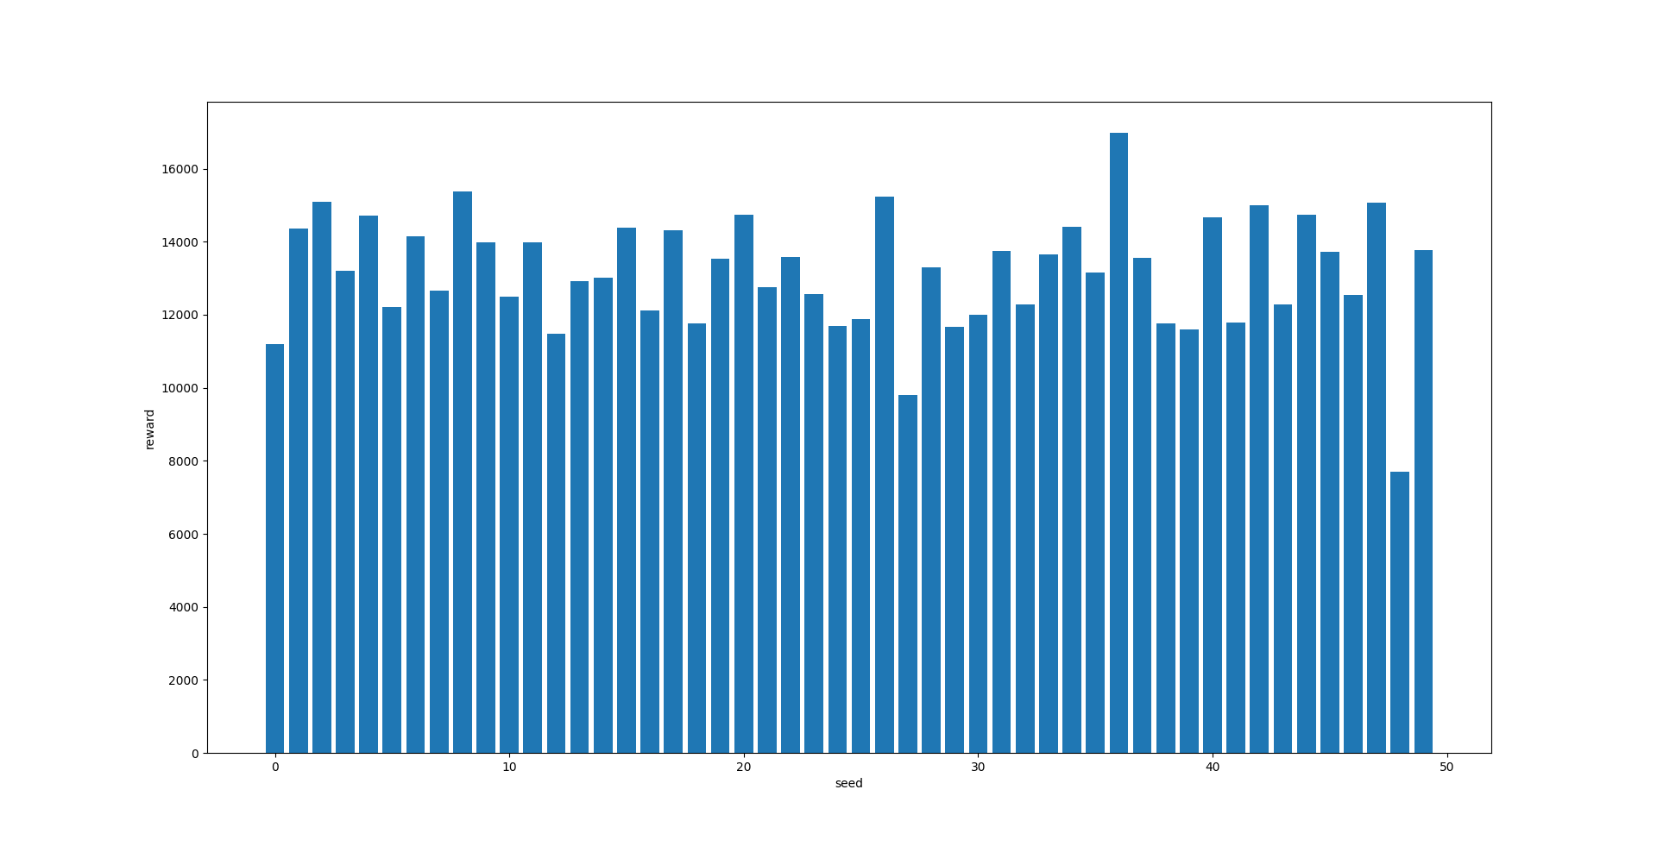
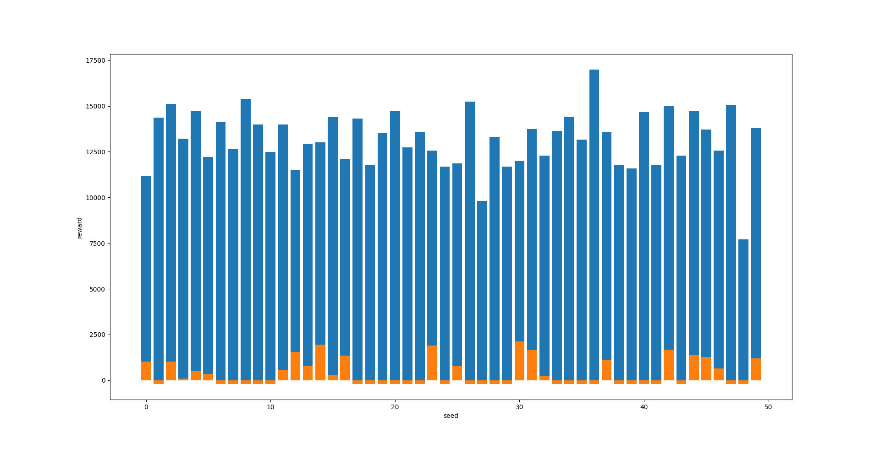
Version 5
Q-Learning
Deep Q-Learning
Policy Gradient

Slide 11
Impact of Hyperparameters

Slide 12
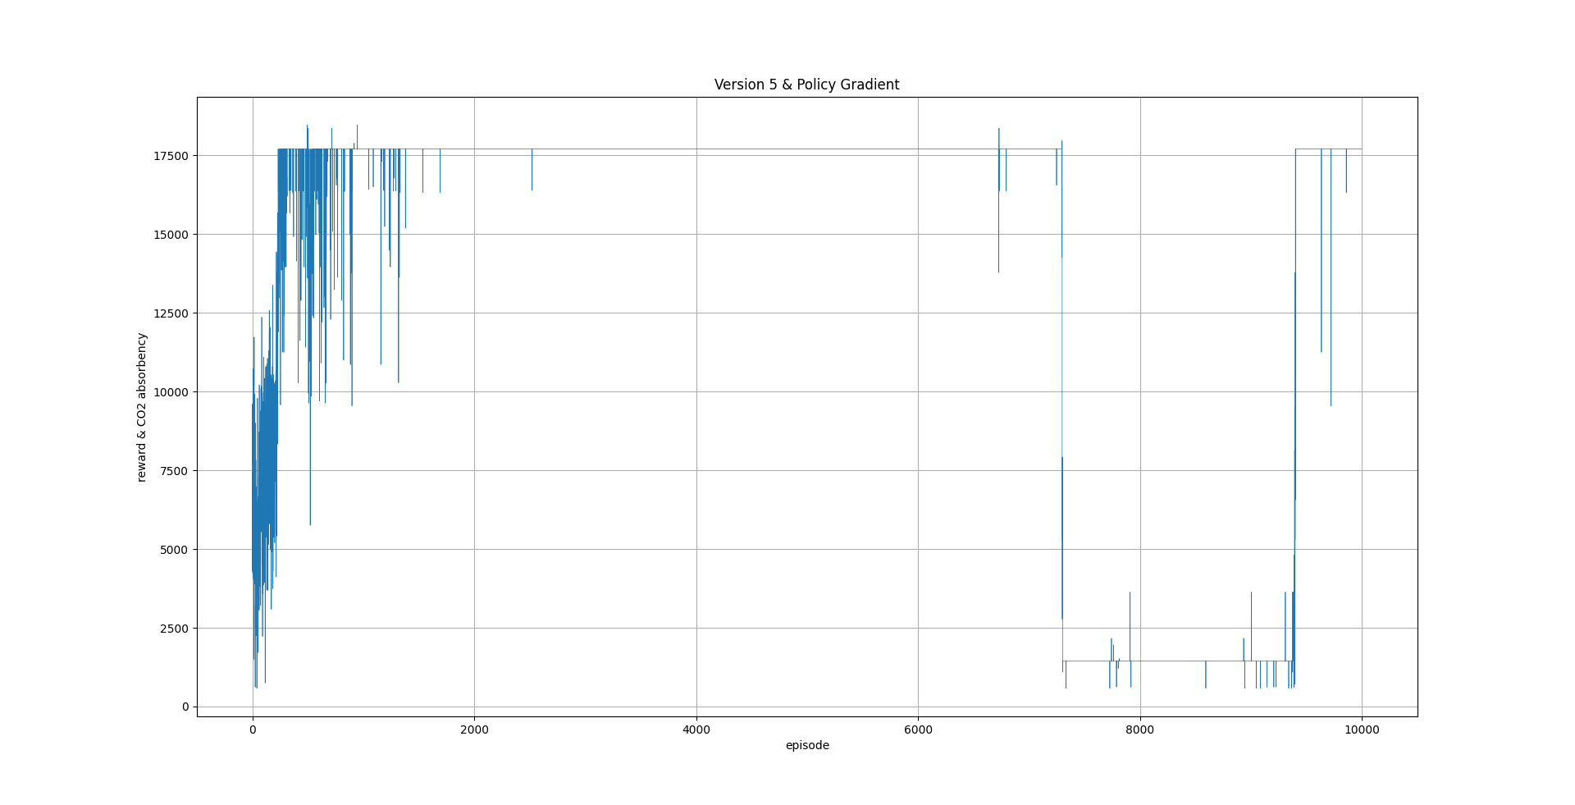
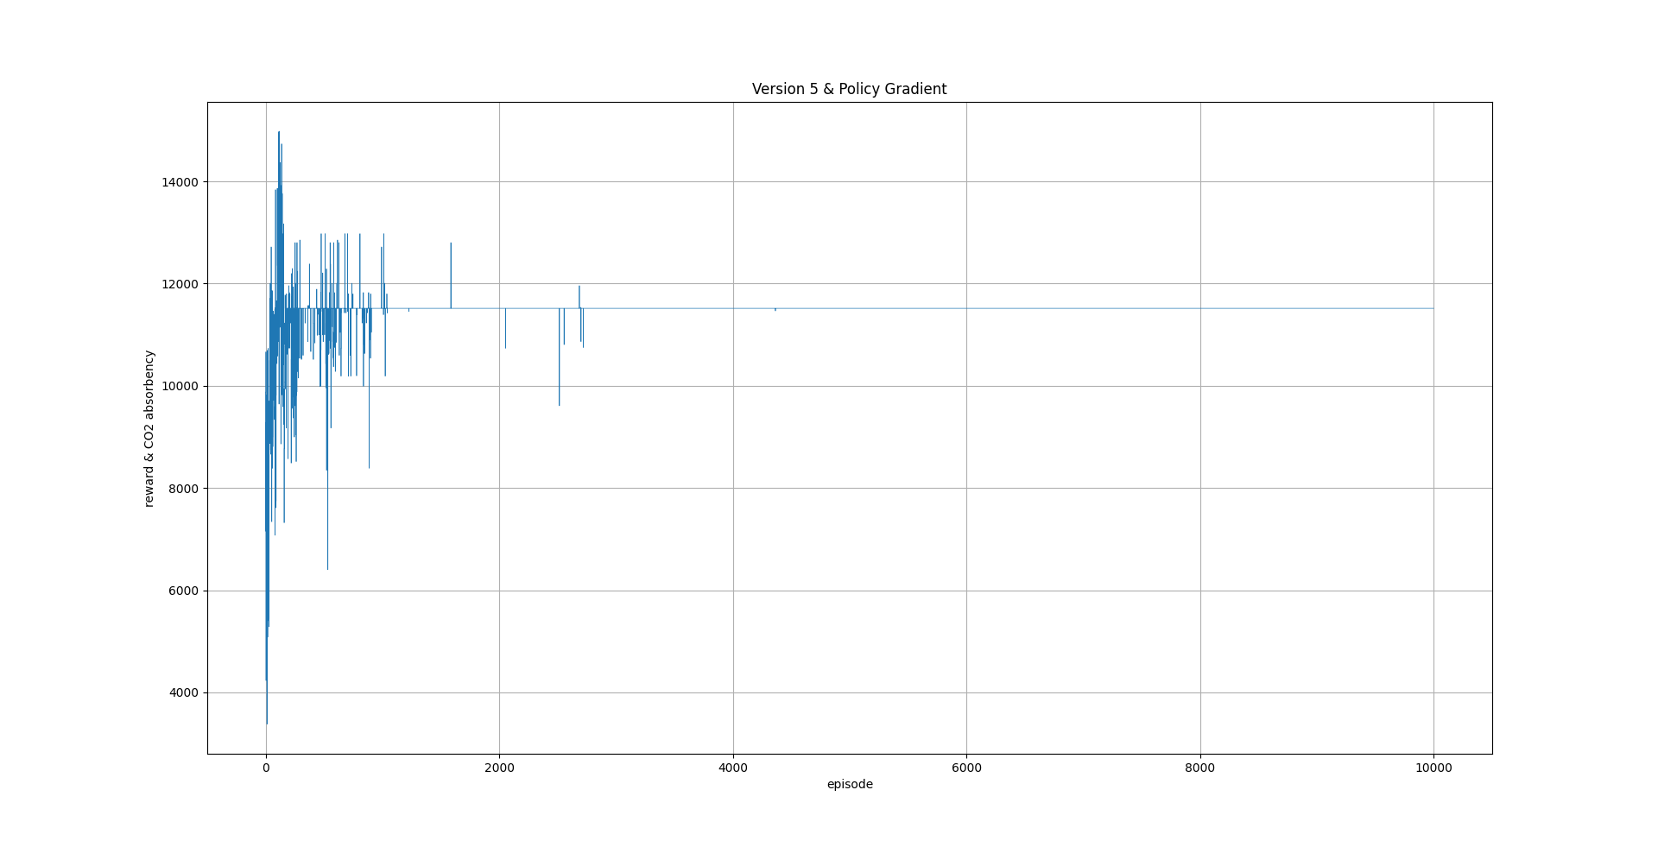
Version 5
Different Hyperparameters settings of Policy Gradient
Hyperparameters: Learning rate: 1e-4, Discount factor: 1.0, Batch size: 128, Hidden layer: 256x512 sigmoid 512x64, Optimizer: Adam
Hyperparameters: Learning rate: 1e-4, Discount factor: 1.0, Batch size: 128, Hidden layer: 256x1024 sigmoid 1024x256, Optimizer: Adam
Hyperparameters: Learning rate: 1e-4, Discount factor: 1.0, Batch size: 128, Hidden layer: 256x64 sigmoid 64x256, Optimizer: Adam

Slide 13

Summary
From the whole building progress of this benchmark we clearly noticed how the complexity of benchmark influences the performance of RL algorithms. And we learned the importance of selecting appropriate RL algorithm for specific environment. Though Gradient Policy generally is powerful than simple RL algorithms e.g. Q-Learning, it still could perform worse if we do not configure it appropriately. Last but not least, our benchmark still has much space to improve, for example, it can be added more factors of nature environment, such as sunlight, temperature etc. Though our benchmark is quite lightweight, it’s still pretty challengeable for state-of-the-art RL algorithms.

